Slide 1
ITP-450: High Performance Computing in Applied Machine Learning
Introduction to Convolutional Neural Networks
Hao Ji
Data Scientist
Center for Advanced Research Computing
Email: haoji@usc.edu

Slide 2
Outline
Section 1: Convolutional Neural Networks
Section 2: Running Deep Learning Applications
Section 3: Transfer Learning
Section 4: Tensorboard
Section 5: Generative AI

Slide 3
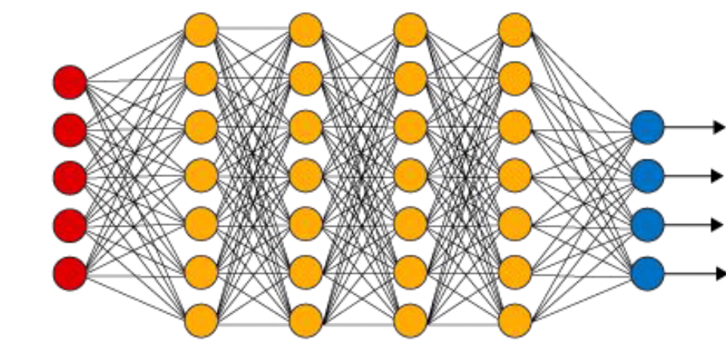
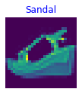
Convolutional Neural Networks
Input X: (32 * 32 * 3)
32x32x3 image -> stretch to 1 dimension of size 3072

Slide 4
Convolutional Neural Networks
32
5 x 5 x 3 filter (initialized with random weights)
32
3
Convolve the filter with the image i.e. “slide over the image spatially, computing dot products”
Filter always extend the depth of image
32 x 32 x 3 image, 5 x 5 x 3 filter
32x32x3 image: Preserve Spatial Structure

Slide 5
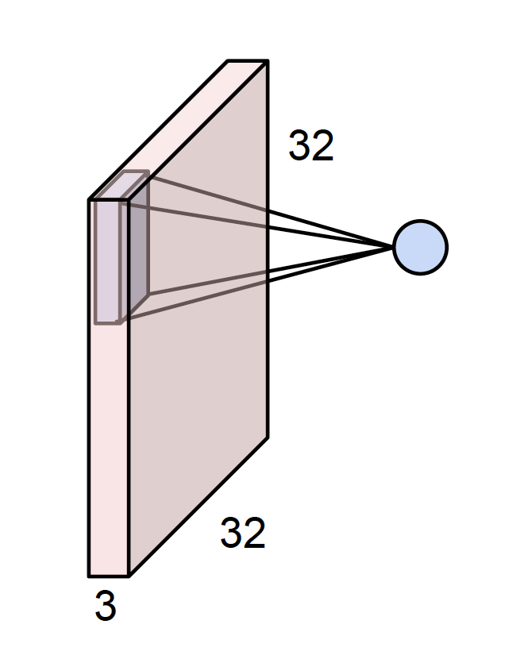
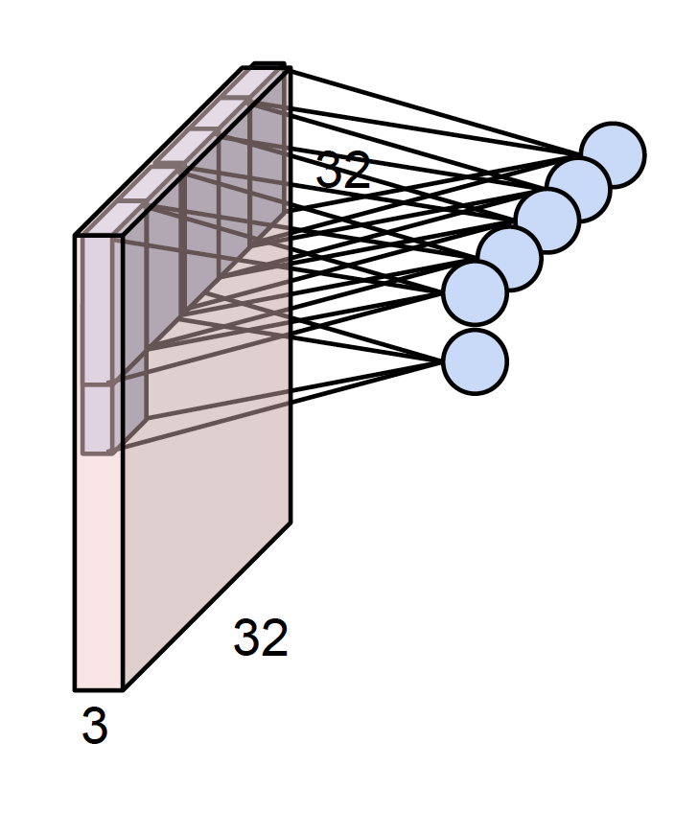
Convolutional Neural Networks
1 number: the result of taking a dot product between the filter and a small 5x5x3 chunk of the image (i.e. 5*5*3 = 75-dimensional dot product + bias)

Slide 6
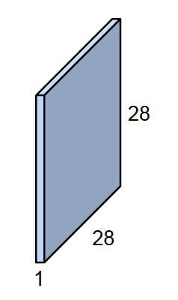
Convolutional Neural Networks
Activation Map/ Feature Map

Slide 7
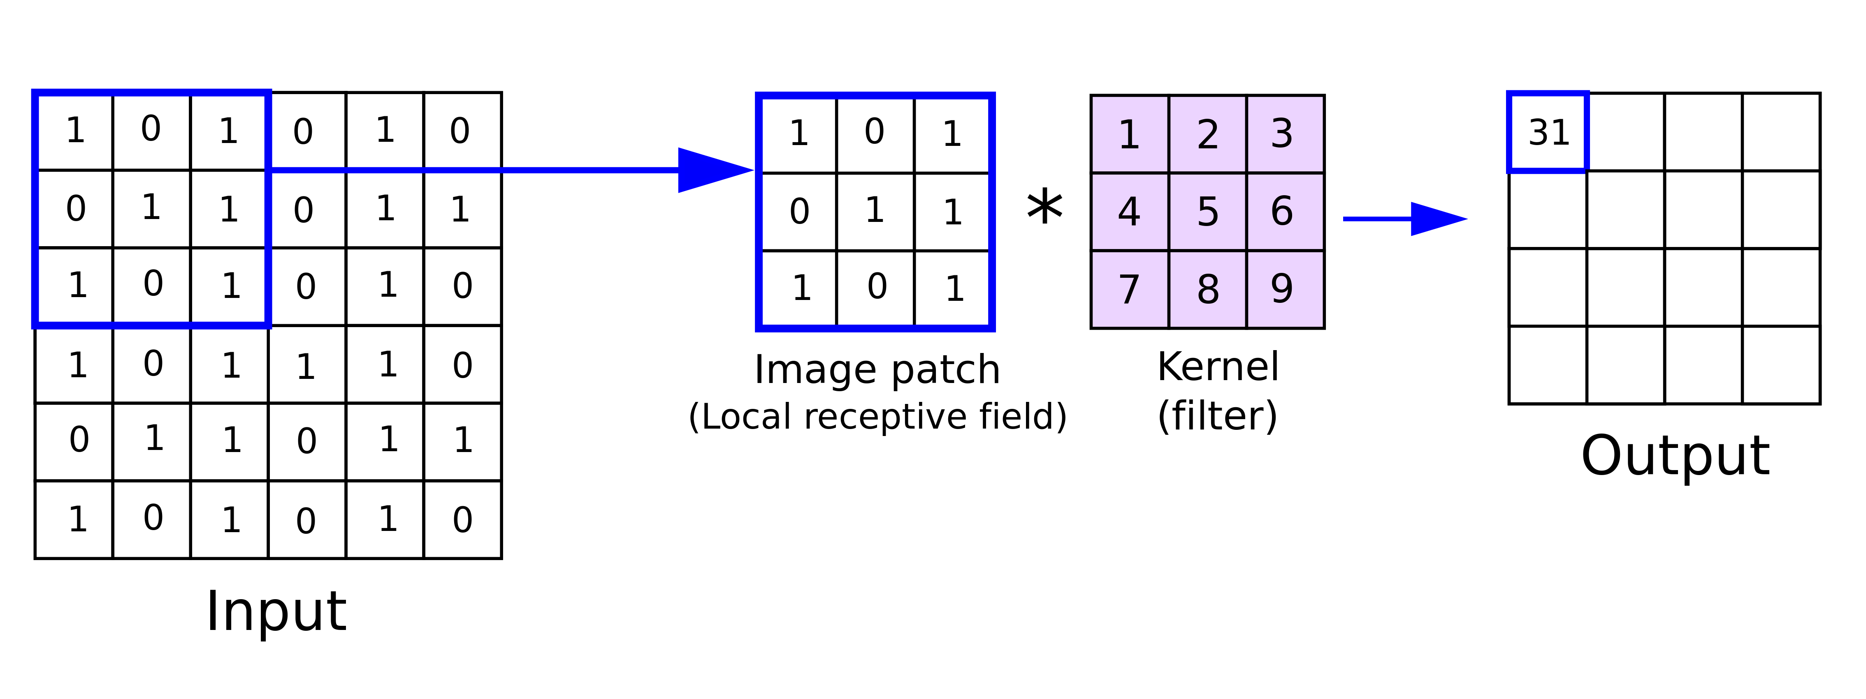
Convolutional Neural Networks

Slide 8
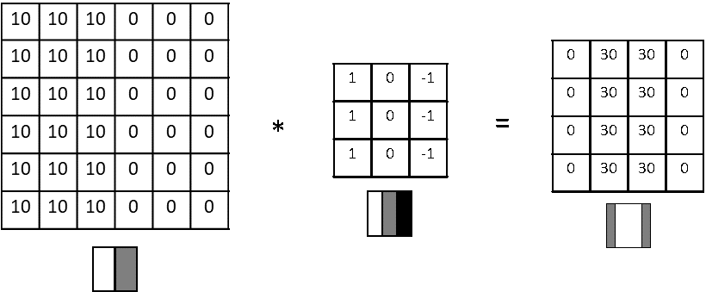
Convolutional Neural Networks
Vertical Edge Detection

Slide 9
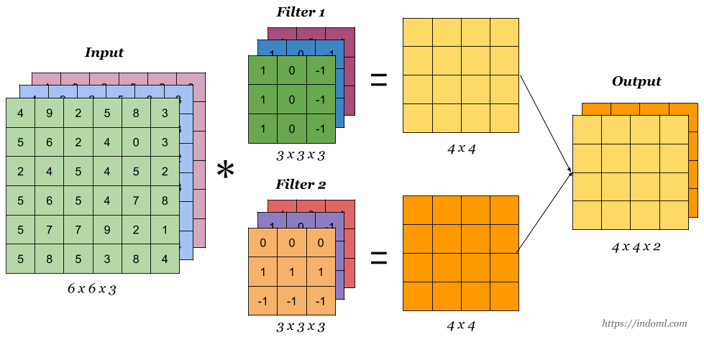
Convolutional Neural Networks

Slide 10
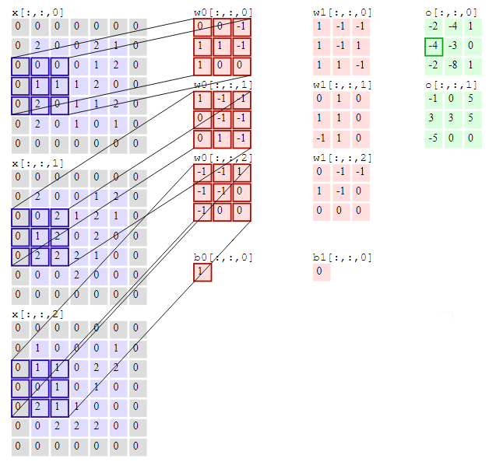
Convolutional Neural Networks

Slide 11
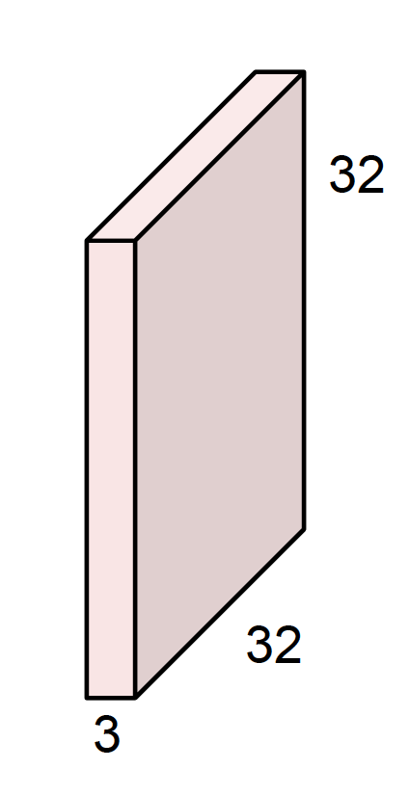
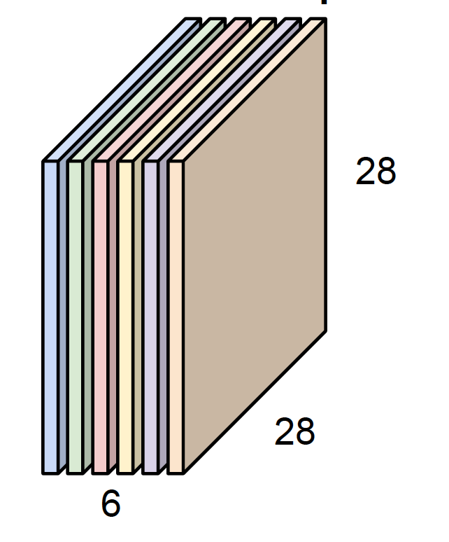
Convolutional Neural Networks
For example, if we had 6 5x5 filters, we’ll get 6 separate activation maps:
We stack these up to get a “new image” of size 28x28x6!

Slide 12
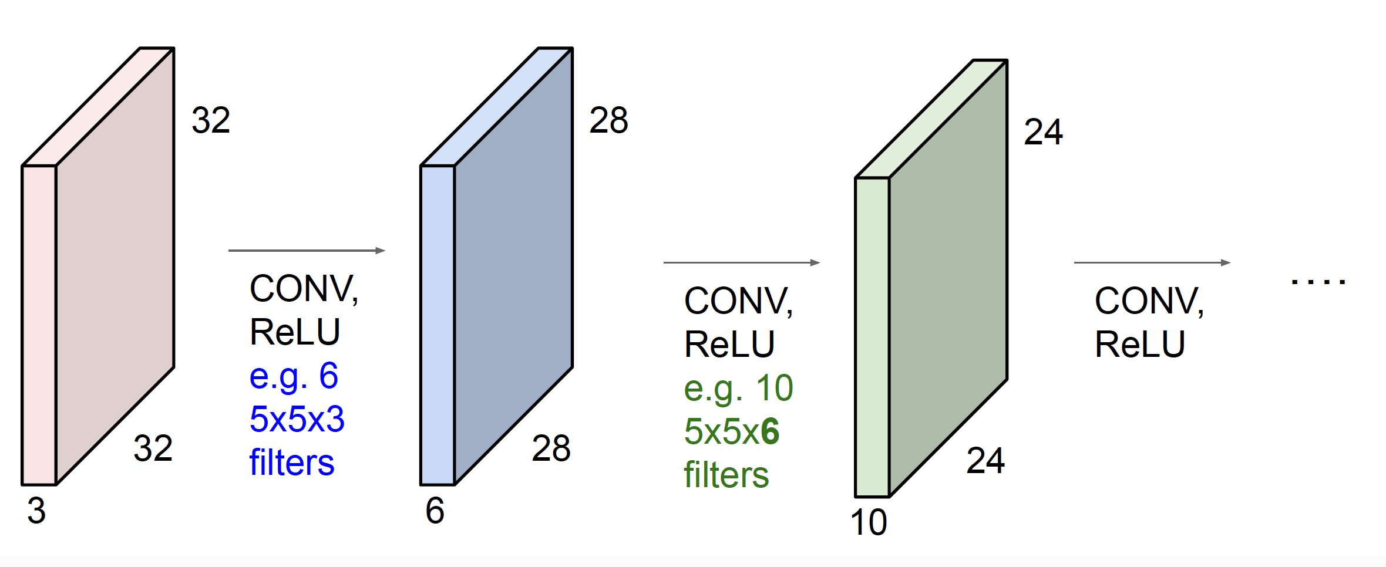
Convolutional Neural Networks
ConvNet is a sequence of Convolution Layers, interspersed with activation functions

Slide 13
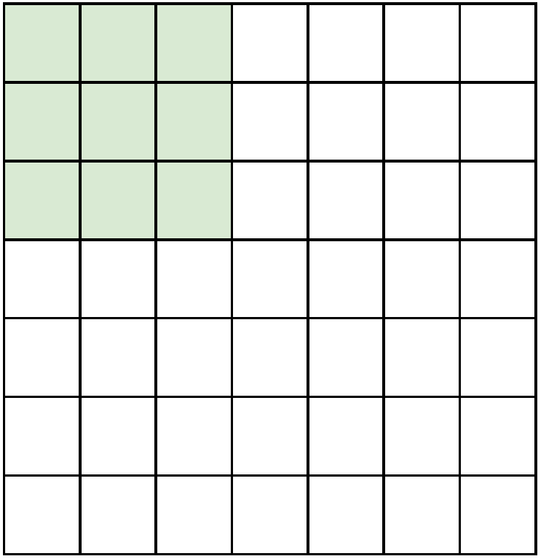
Convolutional Neural Networks
A closer look at spatial dimensions:
7x7 input (spatially) assume 3x3 filter with a stride of 1

Slide 14
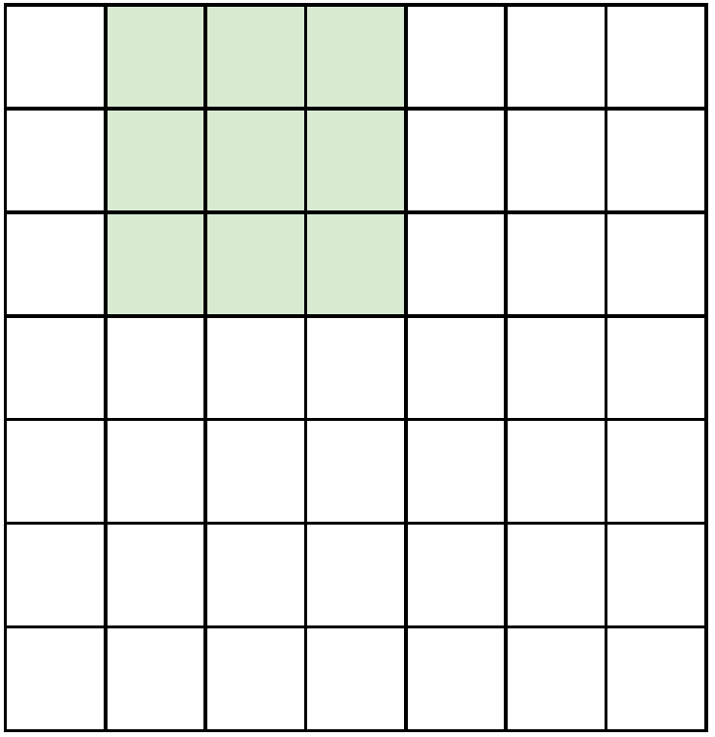
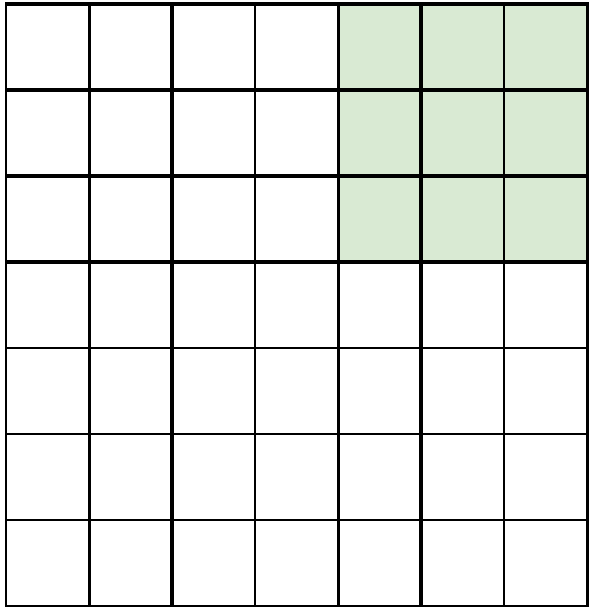
Convolutional Neural Networks
. . .
7x7 Input
5x5 Output

Slide 15
Convolutional Neural Networks
?
7x7 Input

Slide 16
Convolutional Neural Networks
assume 3x3 filter with a stride of 2
3 x 3
7x7 Input

Slide 17
Convolutional Neural Networks
assume 3x3 filter with a stride of 3
Does not fit
cannot apply 3x3 filter on
7x7 input with stride 3
7x7 Input

Slide 18
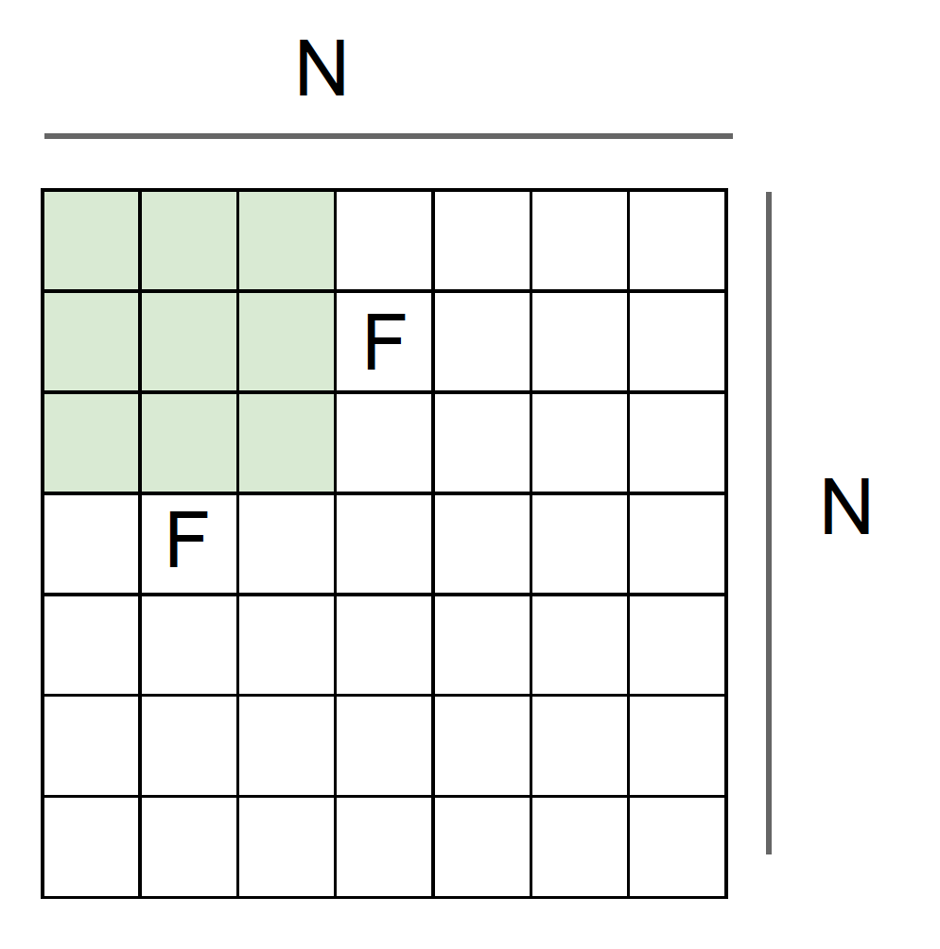
Convolutional Neural Networks
Output size = (N - F) / stride + 1
e.g. N = 7, F = 3:
stride 1 => (7 - 3)/1 + 1 = 5
stride 2 => (7 - 3)/2 + 1 = 3
stride 3 => (7 - 3)/3 + 1 = 2.33 (does not fit)

Slide 19
Convolutional Neural Networks
32x32 input convolved repeatedly with 5x5 filters shrinks volumes spatially!
(32 -> 28 -> 24 ...). Shrinking too fast is not good, doesn’t work well.

Slide 20
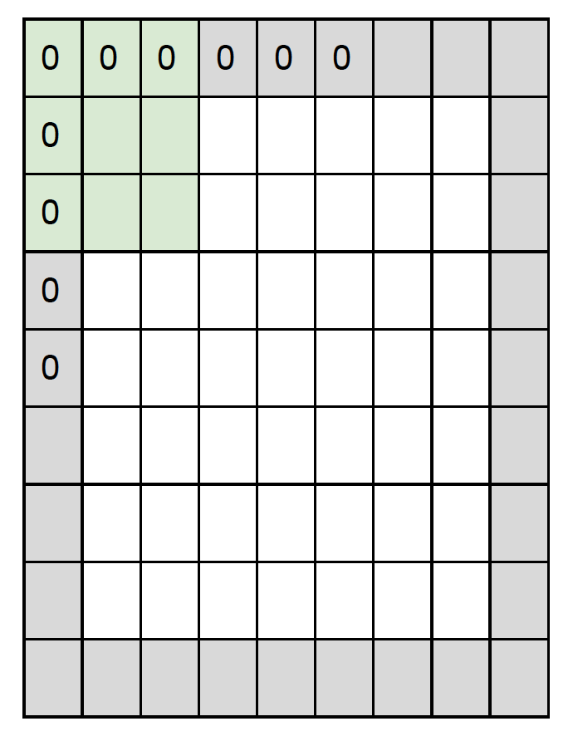
Convolutional Neural Networks
In practice: Common to zero pad the border
e.g.
input image size is 7x7
3x3 filter, applied with stride 1, pad with 1 pixel at the border
=> what is the output?
7x7 output!
Output Size = (N + 2P - F) / stride + 1

Slide 21
Convolutional Neural Networks
Questions:
CONV layers filters of size FxF, stride 1 and zero-padding with ___ pixels will preserve size spatially?

Slide 22
Convolutional Neural Networks
In general, common to see CONV layers with
stride 1, filters of size FxF, and zero-padding with
(F-1)/2. (will preserve size spatially)
e.g. F = 3 => zero pad with 1
F = 5 => zero pad with 2
F = 7 => zero pad with 3

Slide 23
Convolutional Neural Networks
Question
Input volume: 32x32x3
Apply 10 5x5 filters with stride 1, pad 2
What is the output volume size?
Solution
Output volume size:
(32+2*2-5)/1+1 = 32 spatially, so
32x32x10

Slide 24
Convolutional Neural Networks
Common settings:
Number of filters K = (powers of 2, e.g. 32, 64, 128, 512)
- F = 3, S = 1, P = 1
- F = 5, S = 1, P = 2
- F = 1, S = 1, P = 0
Note:
The filter size: F
The stride: S
The zero padding: P

Slide 25
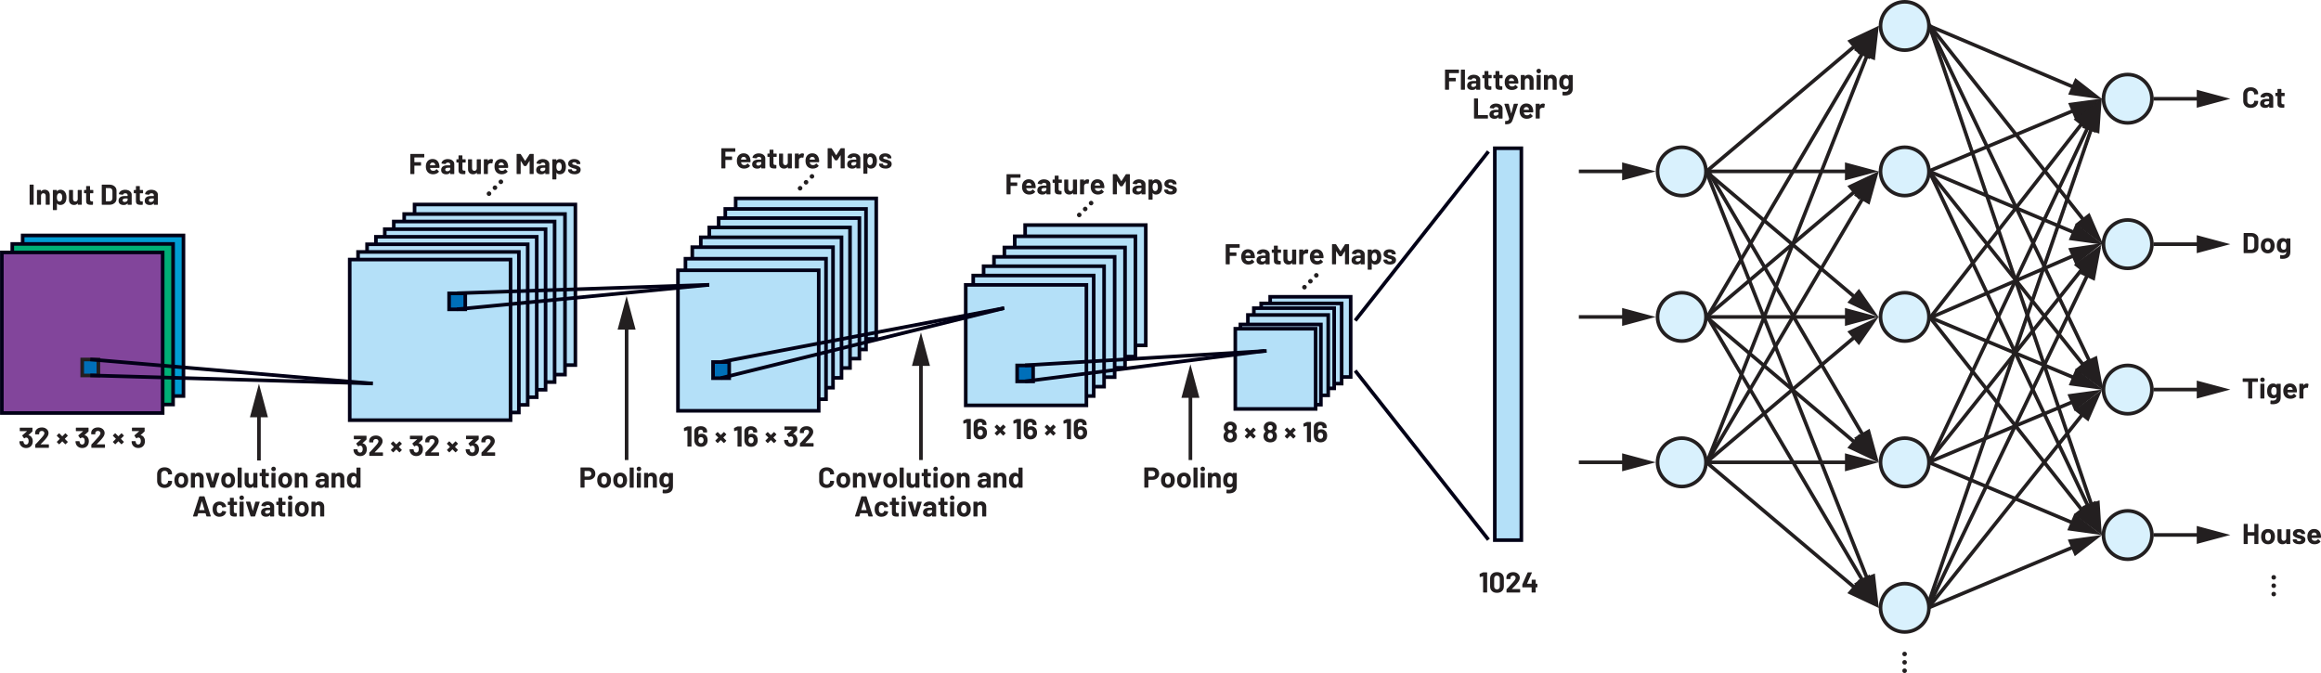
Convolutional Neural Networks
ConvNets stack CONV, POOL, FC layers

Slide 26
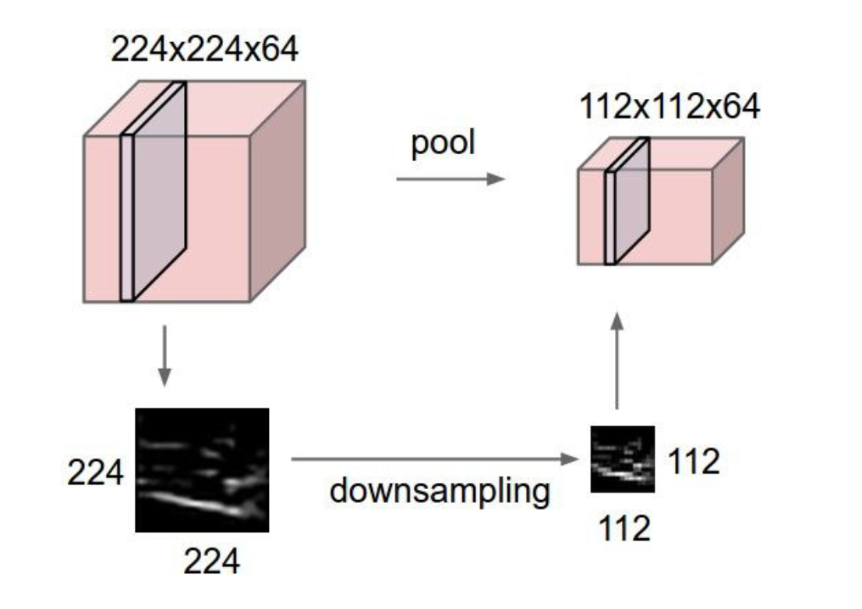
Convolutional Neural Networks
Pooling layer
makes the representations smaller and more manageable
operates over each activation map independently

Slide 27
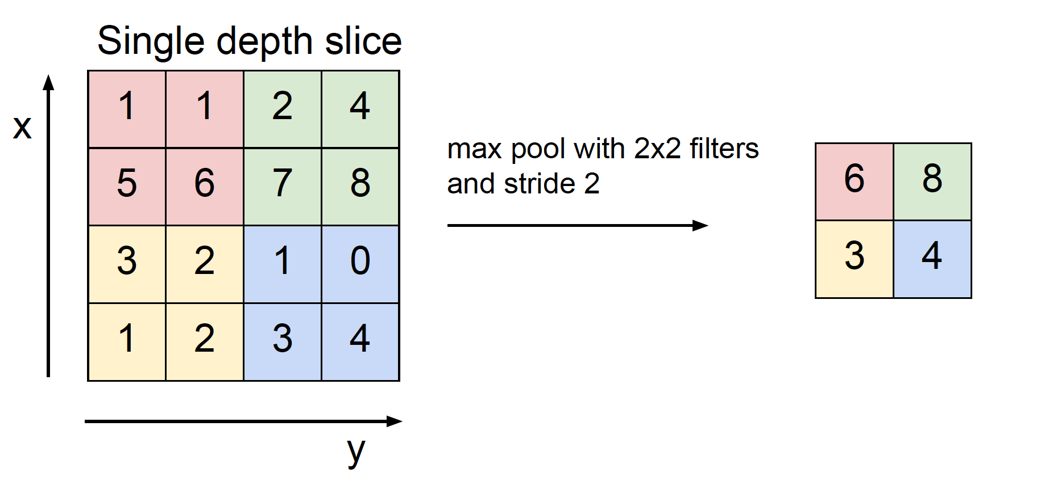
Convolutional Neural Networks
Max Pooling

Slide 28
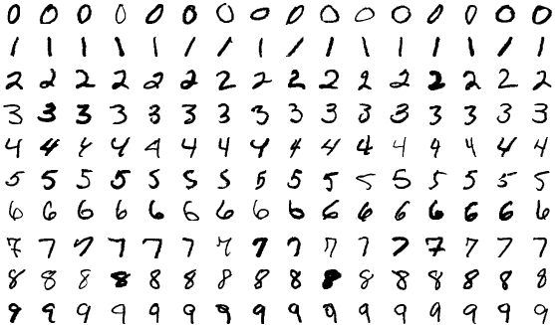
Running Deep Learning Applications
The problem we’re going to solve today is to train a model to classify MNIST datasets. The MNIST database of handwritten digits has a training set of 60,000 examples, and a test set of 10,000 examples.

Slide 29
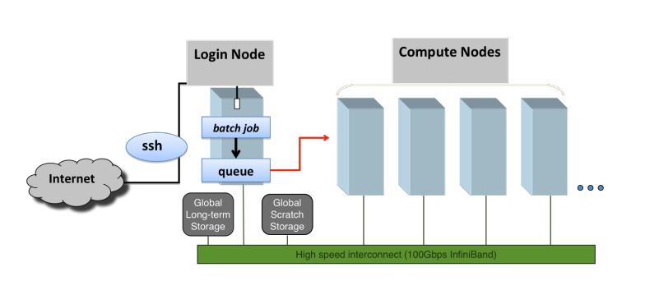
Running Deep Learning Applications

Slide 30

Running Deep Learning Applications
git clone https://github.com/uschpc/Running-DL-Applications.git
SLURM (Simple Linux Utility for Resource Management) is an open-source job scheduler and resource management system designed for high-performance computing (HPC) clusters and supercomputers.
Optimize resource utilization
Manage job submissions
Balance workloads across a cluster of interconnected computing nodes

Slide 31
Transfer Learning
Problem Statement
In practice, very few people train an entire Convolutional Network from scratch (with random initialization), because it is relatively rare to have a dataset of sufficient size.
Instead, it is common to pretrain a ConvNet on a very large dataset (e.g. ImageNet, which contains 1.2 million images with 1000 categories), and then use the ConvNet either as an initialization or a fixed feature extractor for the task of interest.

Slide 32
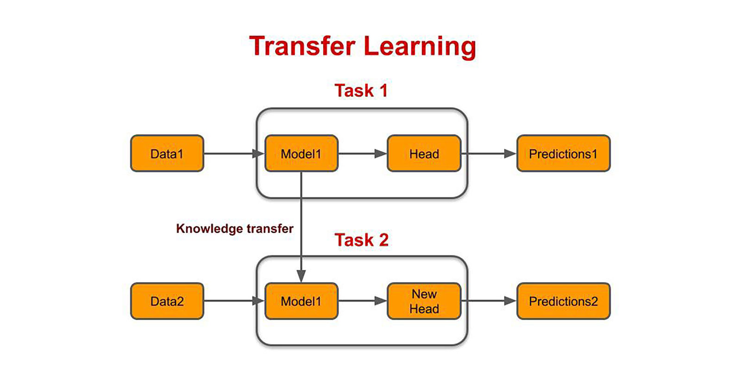
Transfer Learning

Slide 33
Transfer Learning
Finetuning:
We initialize the network with a pretrained network Instead of random initialization, like the one that is trained on imagenet 1000 dataset. Rest of the training looks as usual.
Feature Extractor:
Here, we will freeze the weights for all of the network except that of the final fully connected layer. This last fully connected layer is replaced with a new one with random weights and only this layer is trained.

Slide 34
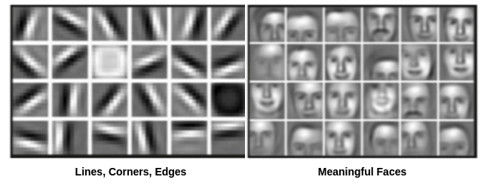
Transfer Learning
Low-level features are essential aspects of an image or video.
Contours, edges, angles, and colors are instances of low-level characteristics.
High-level characteristics are more conceptual and thematically significant.
Items, scenarios, and interactions are instances of high-level features.

Slide 35
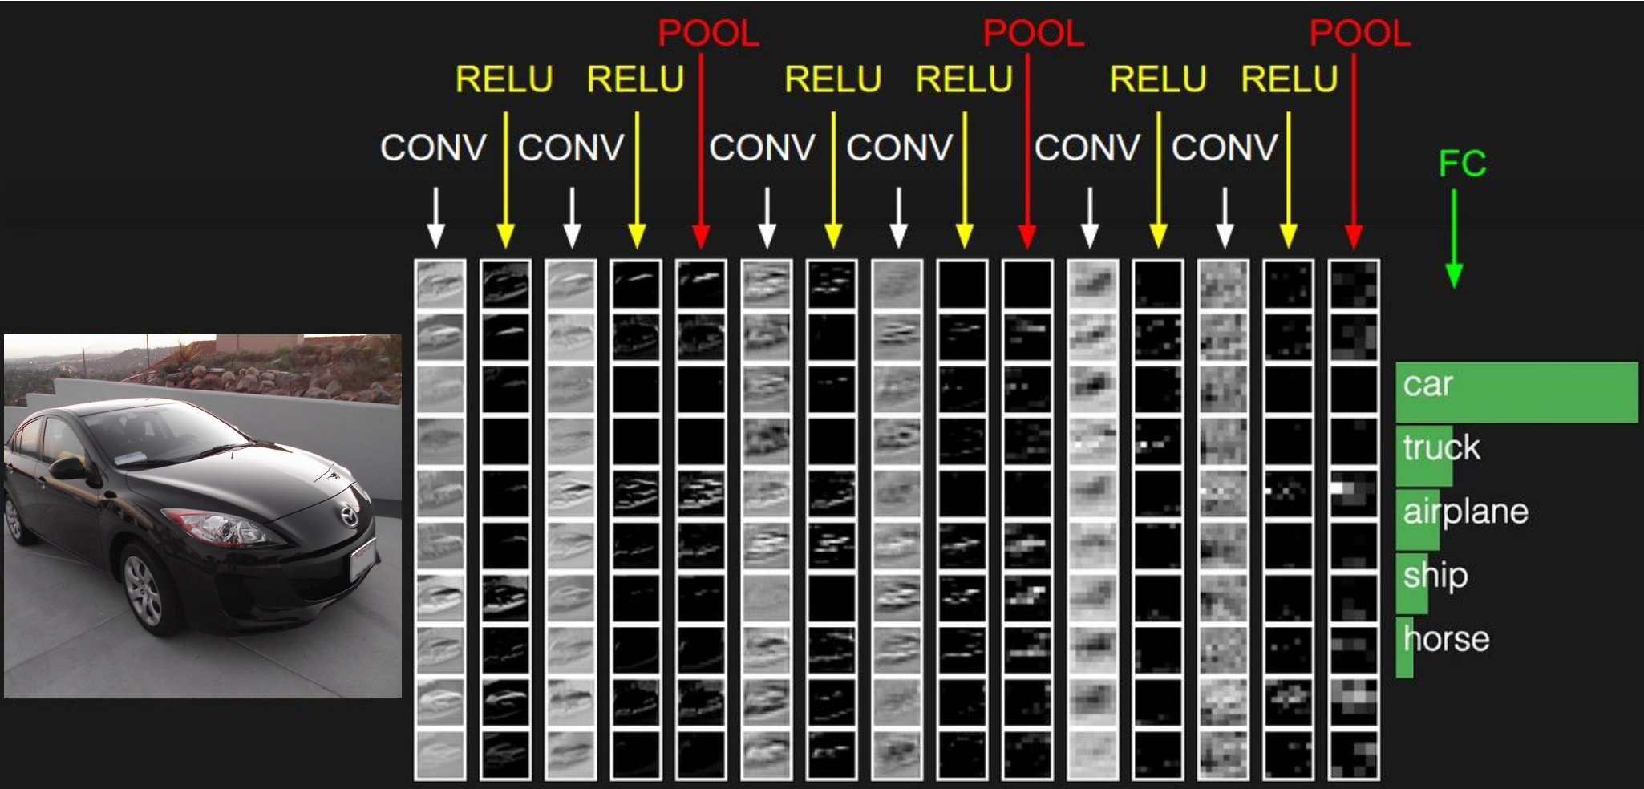
Transfer Learning
Low-level features
High-level features

Slide 36
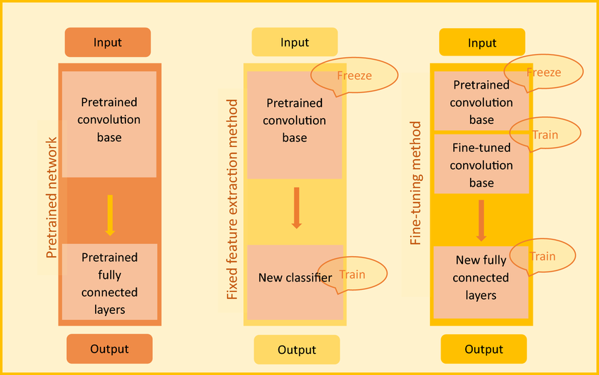
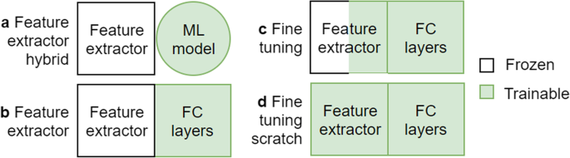
Transfer Learning
Feature Extraction vs Fine-tuning Method
Keeping in mind that ConvNet features are more generic in early layers and more original-dataset-specific in later layers.

Slide 37
Transfer Learning
Which transfer Learning method to use?
This is a function of several factors, but the two most important ones are:
Size of the new dataset (small or big)
Similarity of the new dataset to the original dataset (e.g. ImageNet-like in terms of the content of images and the classes, or very different, such as microscope images).

Slide 38
Transfer Learning
New dataset is small and similar to the original dataset
Feature extraction
New dataset is large and similar to the original dataset
Finetuning
New dataset is small and different from the original dataset
New dataset is large and different from the original dataset

Slide 39
Transfer Learning
Here are some common rules of thumb for navigating the 4 major scenarios:
New dataset is small and similar to original dataset.
Since the data is small, it is not a good idea to fine-tune the ConvNet due to overfitting concerns. Since the data is similar to the original data, we expect higher-level features in the ConvNet to be relevant to this dataset as well. Hence, the best idea might be to train a linear classifier on the CNN codes.
New dataset is large and similar to the original dataset.
Since we have more data, we can have more confidence that we won’t overfit if we were to try to fine-tune through the full network.
New dataset is small but very different from the original dataset.
Since the data is small, it is likely best to only train a linear classifier. Since the dataset is very different, it might not be best to train the classifier form the top of the network, which contains more dataset-specific features. Instead, it might work better to train the SVM classifier from activations somewhere earlier in the network.
New dataset is large and very different from the original dataset.
Since the dataset is very large, we may expect that we can afford to train a ConvNet from scratch. However, in practice it is very often still beneficial to initialize with weights from a pretrained model. In this case, we would have enough data and confidence to fine-tune through the entire network.

Slide 40
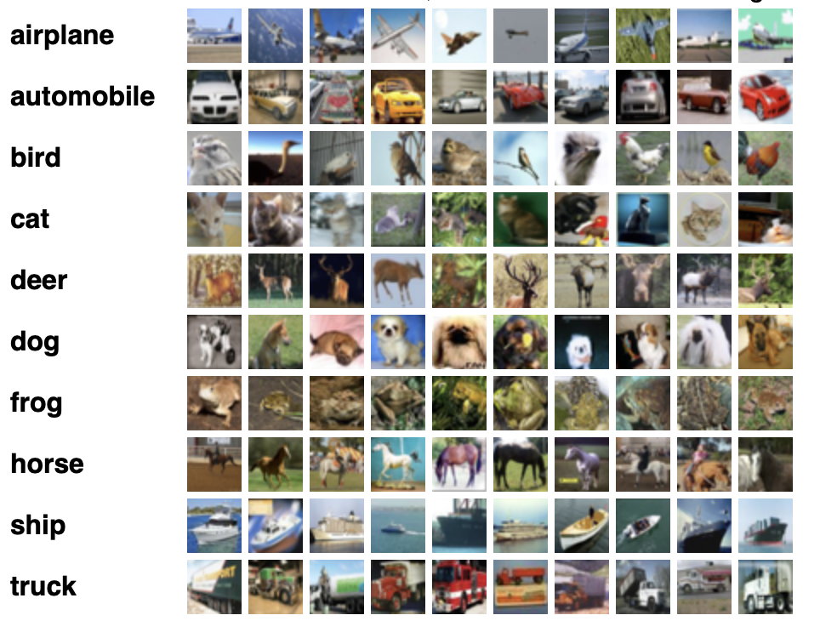
Transfer Learning
The problem we’re going to solve today is to train a model to classify CIFAR10 datasets.
CIFAR-10 dataset consists of 60000 32x32 color images in 10 classes, with 6000 images per class.
There are 50000 training images and 10000 test images.
We will use Restnet18 pretrained model as a basis for transfer learning.

Slide 41
Tensorborad
Installation: conda install matplotlib tensorboard
Showing images in TensorBoard
Graphing scalers and metrics to visualize training
Visualizing your model graphs
Tensorboard Tutorial: https://pytorch.org/tutorials/beginner/introyt/tensorboardyt_tutorial.html

Slide 42
Tensorborad
Installation:
mamba activate torch_env
mamba install matplotlib tensorboard

Slide 43
Tensorborad
Launch ‘Terminal’ Apps in OpenOnDemand :
Go to your Week9 folder: cd /project/irahbari_1147/username/Week9
Activate your Conda environment: conda activate torch_env
Launch Tensorboard in your Conda environment: tensorboard --logdir=runs
Right Click on the http://localhost:6006/ link and select ‘Open link’, this will launch a browser and start Tensorboard

Slide 44
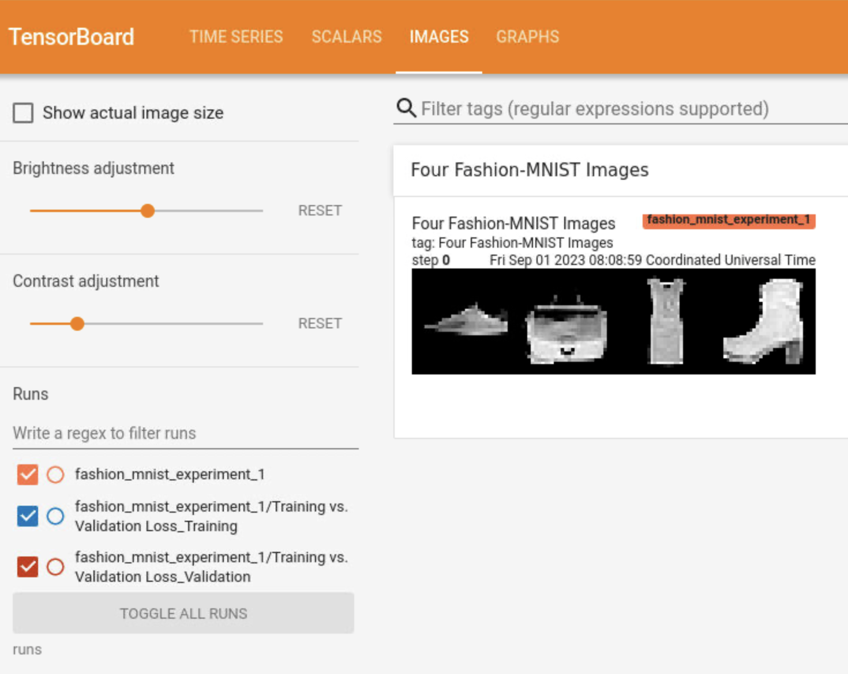
Tensorborad
Showing images in TensorBoard

Slide 45
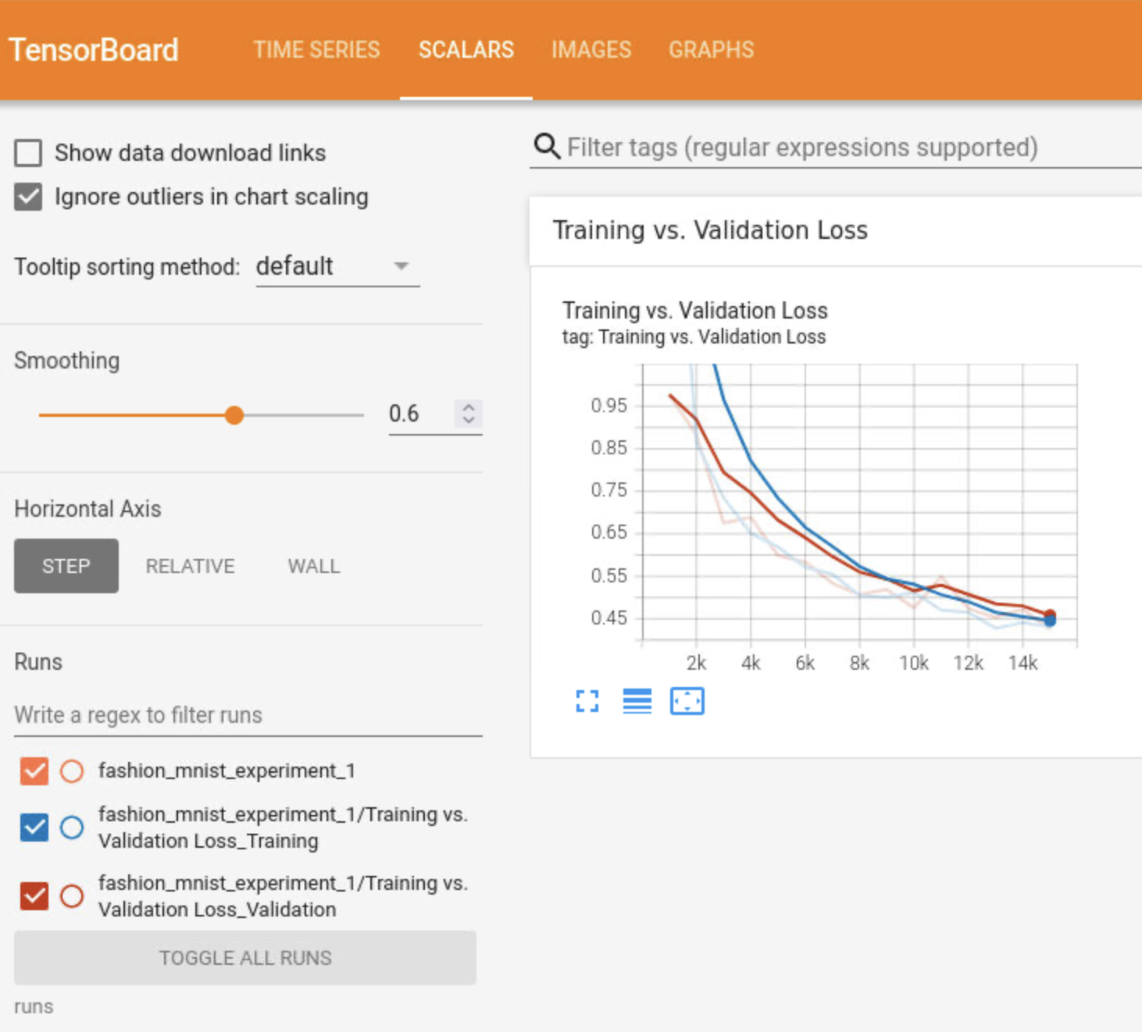
Tensorborad
Graphing Scalers and metrics to visualize training

Slide 46
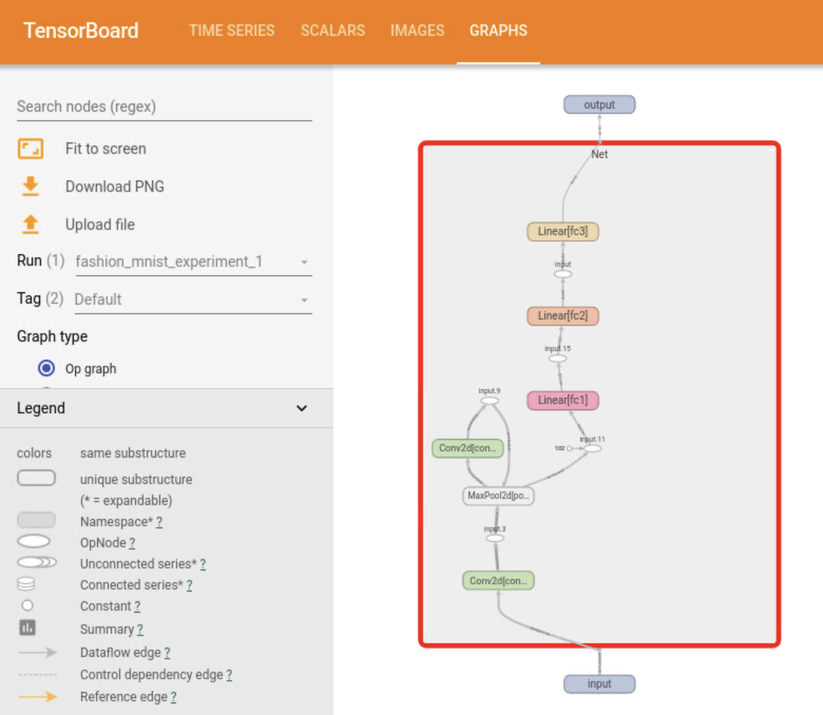
Tensorborad
Visualizing model graphs

Slide 47

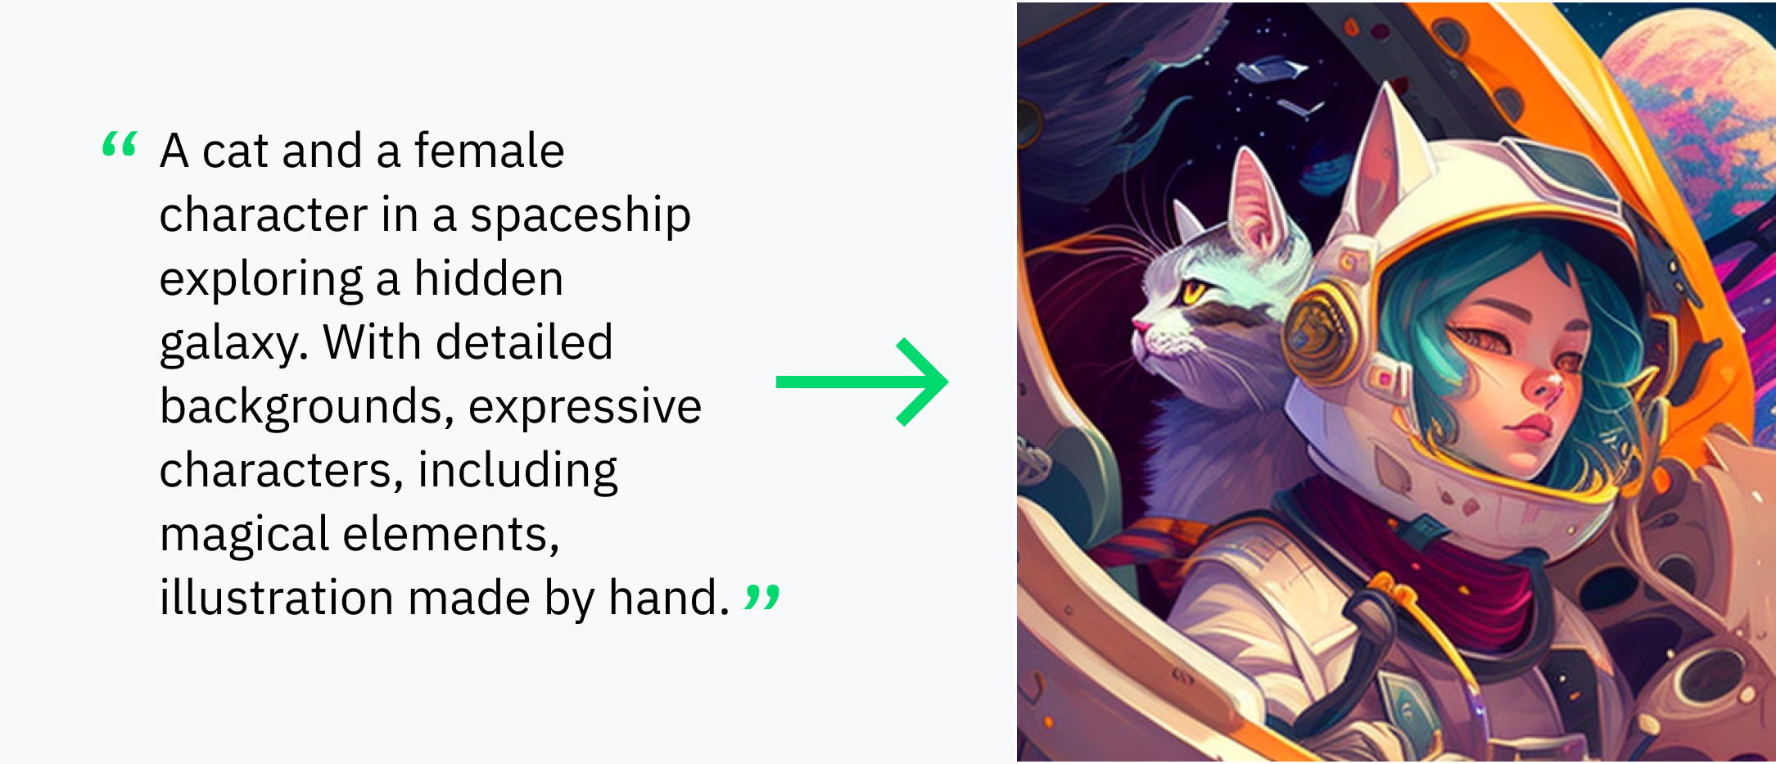
Generative AI
Generative: creates new content (text, images, audio, synthetic data) based on what it has learned from existing contents.
AI: uses neural networks to identify the patterns and structures within existing data
Text to text generation (ChatGPT)
Text to image generation (Dall-E 2)

Slide 48
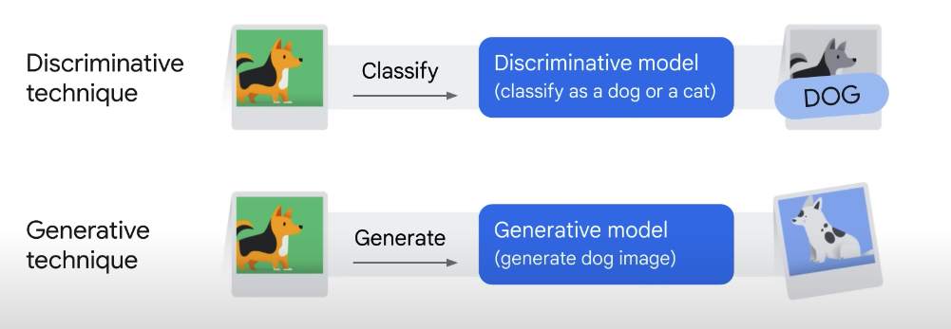
Generative AI
Discriminative Model | Generative Model
Classify or predict | Generates new data similar to the trained data
Labeled data | Unstructured data
Learns the relationship between data and labels | Understands distribution of data

Slide 49

Generative AI

Slide 50
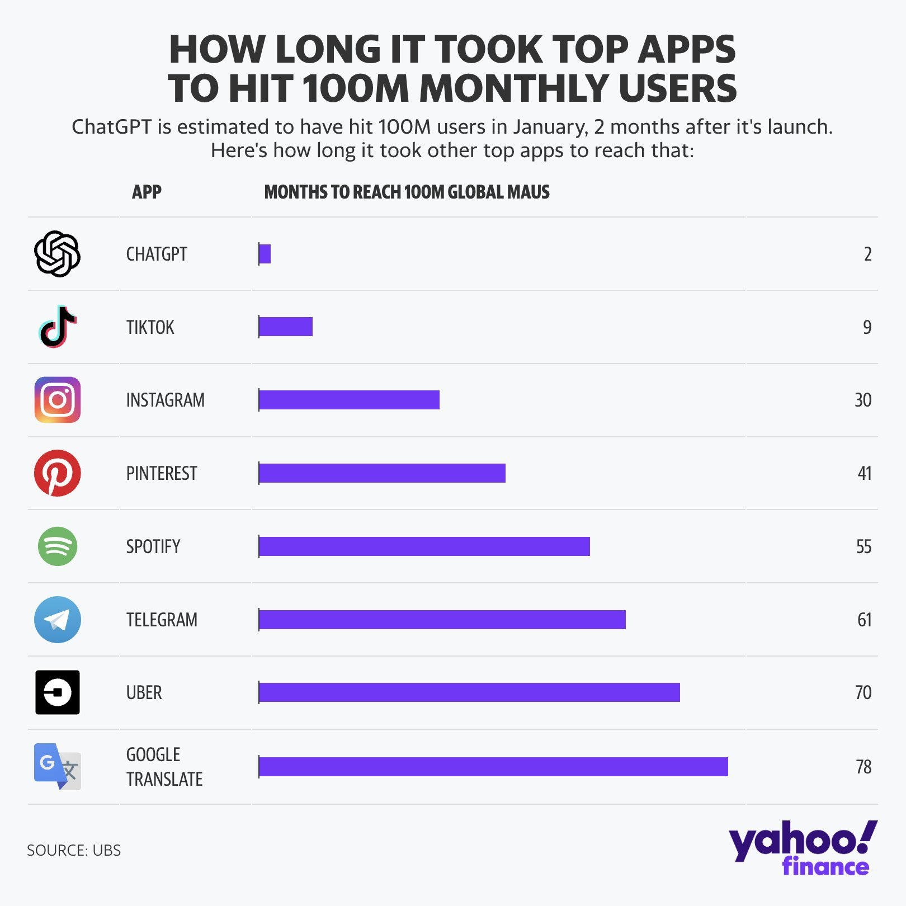
Generative AI

